Slide 1
LECTURE # 7
RELATIONS

Slide 2
n-ary Relations and Their Applications
We can have relation between more than just 2 sets
A binary relation involves 2 sets and can be described by a set of pairs
A ternary relation involves 3 sets and can be described by a set of triples
…
An n-ary relation involves n sets and can be described by a set of n-tuples
Relations are used to represent computer databases
.

Slide 3
AN EXAMPLE
n-ary Relations
The domains of the relation are the set of natural numbers
Note: N is the set of natural numbers {0,1,2,3,…}
The relation has degree 3

Slide 4
Relational databases
Relational databases
The relational data model
Database is made up of records.
Typical operations on a database are
find records that satisfy a given criteria
delete records
add records
update records
Database made up of records, they are n-tuples, made up of fields
Student record might look as follows
(name,metricNo,faculty,gpa)
gpa is an attribute
Some everyday databases
student records
health records
tax information
telephone directories
banking records
…
(Jones,200401986,Arts,4.9)
(Lee,200408972,Science,3.6)
(Kuhns,200501728,Humanities,5.0)
(Moore,200308327,Science,5.5)
relations (in relDB) also called tables
Databases may be represented
using the relational model

Slide 5
Relational databases
The relational data model
Example from the book
Attributes: name, metric No, Dept and GPA
primary key:
An attribute/domain/column is a primary key when
the value of this attribute uniquely defines tuples
i.e. no two tuples have the same value for that attribute
Name cannot be a primary key, neither can Dept or GPS
metricNo is a primary key

Slide 6
Relational databases
Selection
Operations on n-ary relations

Slide 7
Relational databases
Join
Operations on n-ary relations
Joins two tables/relations together, matching up on specific attributes

Slide 8
Relational databases
Join
Operations on n-ary relations

Slide 9
Closure
The closure of a relation R with respect to property P is the relation obtained by adding the minimum number of ordered pairs to R to obtain property P.
Reflexive Closure
Theorem
The reﬂexive closure of a relation R on A is obtained by adding (a, a) to R for each a ∈ A.
The reflexive closure of R is R U ∆,
where ∆ = { (a,a) | a ∈ R } is the diagonal relation on A.

Slide 10
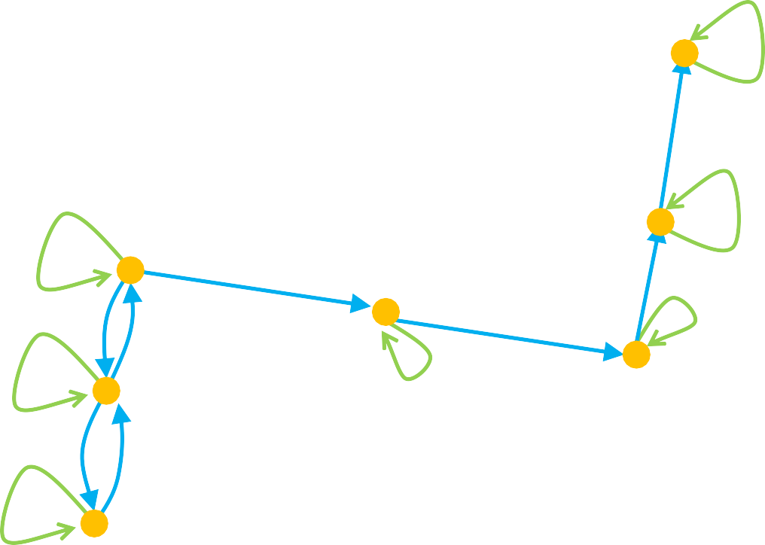
Reflexive Closure
Consider a relation R:
We want to add edges to make the relation reflexive
By adding those edges, we have made a non- reflexive relation R into a reflexive relation
This new relation is called the reflexive closure of R

Slide 11
Symmetric Closure
Definition
Let R be a relation on A. Then R ⁻¹ or the inverse of R is the relation
R ⁻¹ = { < y,x > | < x, y > ∈ R}
NOTE: This relation is sometimes denoted as R^{T} or R^{c} and called the converse of R
Theorem
Let R be a relation on A. The symmetric closure of R, denoted s(R),is the relation R ∪ R⁻¹.

Slide 12
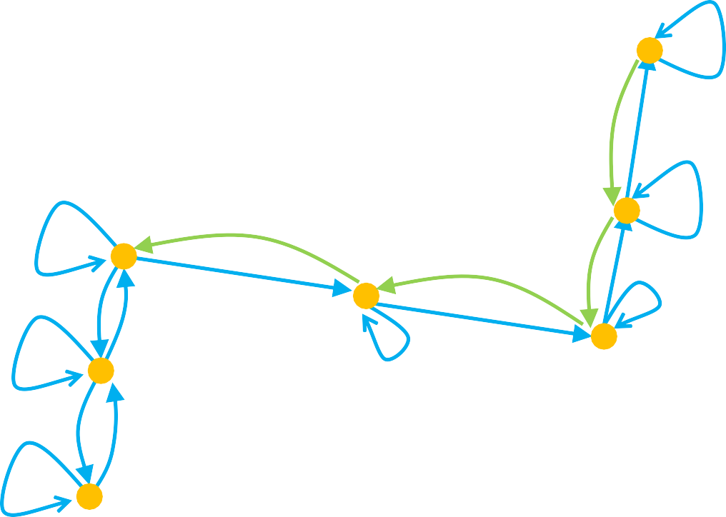
Symmetric Closure
Let’s go back to the previous relation R:
We want to add edges to make the relation symmetric
By adding those edges, we have made a non- symmetric relation R into a symmetric relation
This new relation is called the symmetric closure of R

Slide 13
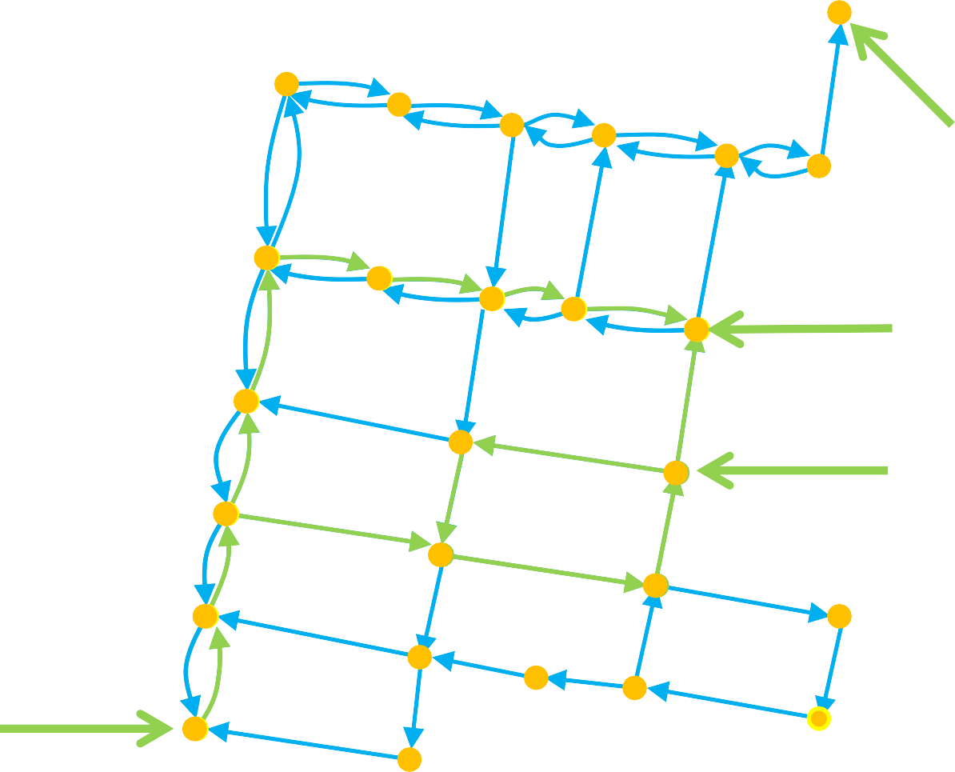
Paths in directed graphs
A path is a sequences of connected edges from vertex a to vertex b
No path exists from
the noted start location
Start (a)
A path that starts and ends at the same vertex is called a circuit or cycle
Must have length ≥1
End (b)
Start (a)
End (b)
Start (a)

Slide 14
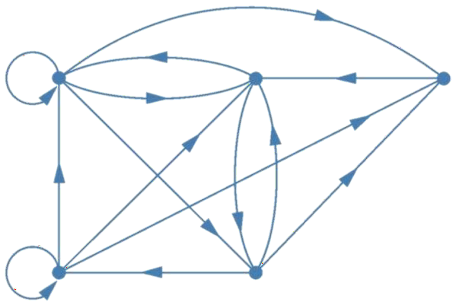




Example
Which of the following are paths in the directed graph shown in the figure: a,b,e,d; a,e,c,d,b; b,a,c,b,a,a,b; d,c; c,b,a; e,b,a,b,a,b,e?
What are the lengths of those that are paths? Which of the paths in this list are circuits?
a
b
c
d
e

Slide 15
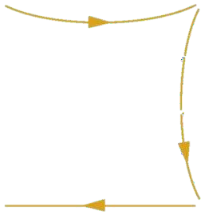
Solution
Which of the following are paths in the directed graph shown in the figure: a,b,e,d; a,e,c,d,b; b,a,c,b,a,a,b; d,c; c,b,a; e,b,a,b,a,b,e?
a
b
c
a,b,e,d is a path of length 3.
d
e

Slide 16



Solution
Which of the following are paths in the directed graph shown in the figure: a,b,e,d; a,e,c,d,b; b,a,c,b,a,a,b; d,c; c,b,a; e,b,a,b,a,b,e?
a
b
c
a,b,e,d is a path of length 3. a,e,c,d,b is not a path.
d
e

Slide 17



Solution
Which of the following are paths in the directed graph shown in the figure: a,b,e,d; a,e,c,d,b; b,a,c,b,a,a,b; d,c; c,b,a; e,b,a,b,a,b,e?
a
b
c
a,b,e,d is a path of length 3. a,e,c,d,b is not a path. b,a,c,b,a,a,b is a path of length 6.
d
e

Slide 18


Solution
Which of the following are paths in the directed graph shown in the figure: a,b,e,d; a,e,c,d,b; b,a,c,b,a,a,b; d,c; c,b,a; e,b,a,b,a,b,e?
a
b
c
a,b,e,d is a path of length 3. a,e,c,d,b is not a path. b,a,c,b,a,a,b is a path of length 6. d,c is a path of length 1.
d
e

Slide 19

Solution
Which of the following are paths in the directed graph shown in the figure: a,b,e,d; a,e,c,d,b; b,a,c,b,a,a,b; d,c; c,b,a; e,b,a,b,a,b,e?
a
b
c
a,b,e,d is a path of length 3. a,e,c,d,b is not a path. b,a,c,b,a,a,b is a path of length 6. d,c is a path of length 1.
c,b,a is a path of length 2.
d
e

Slide 20


Solution
Which of the following are paths in the directed graph shown in the figure: a,b,e,d; a,e,c,d,b; b,a,c,b,a,a,b; d,c; c,b,a; e,b,a,b,a,b,e?
a
b
c
a,b,e,d is a path of length 3. a,e,c,d,b is not a path. b,a,c,b,a,a,b is a path of length 6. d,c is a path of length 1.
c,b,a is a path of length 2. e,b,a,b,a,b,e is a path of length 6.
d
e

Slide 21
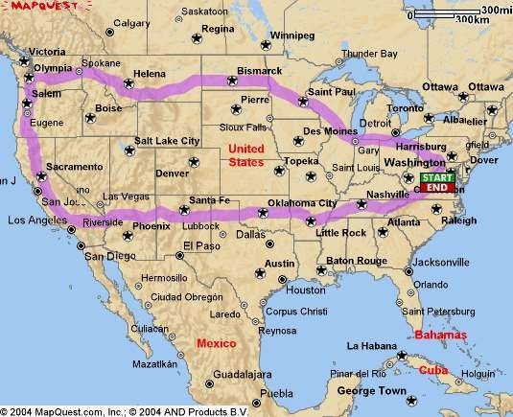
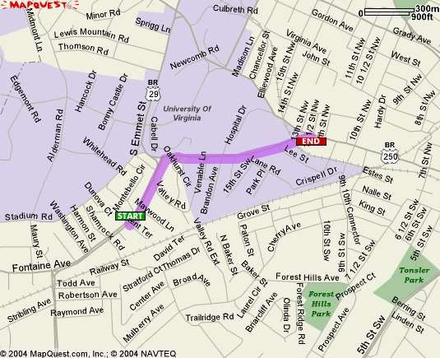
Shortest Path
What is really needed in most
applications is finding the shortest path between two vertices

Slide 22


Transitive Closure
Informal definition: If there is a path from a to b, then there should be an edge from a to b in the transitive closure
First take of a definition:
In order to find the transitive closure of a relation R, we add an edge from a to c, when there are edges from a to b and b to c
But there is a path from 1 to 4 with no edge!
We will study different algorithms for determining the transitive closure
R = { (1,2), (2,3), (3,4) }
(1,2) & (2,3) ∴ (1,3)
(2,3) & (3,4) ∴ (2,4)
4
4
1
1
2
3
2
3

Slide 23

Transitive Closure
Definition
The connectivity relation or the star closure of the relation R, denoted R*, is the set of ordered pairs <a, b> such that there is a path (in R) from a to b:

Slide 24

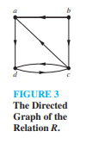


Slide 25

